Slide 1

CEN TC 442 WG2 | TG1
Building Information Modelling –
Level of Information Need

Slide 2
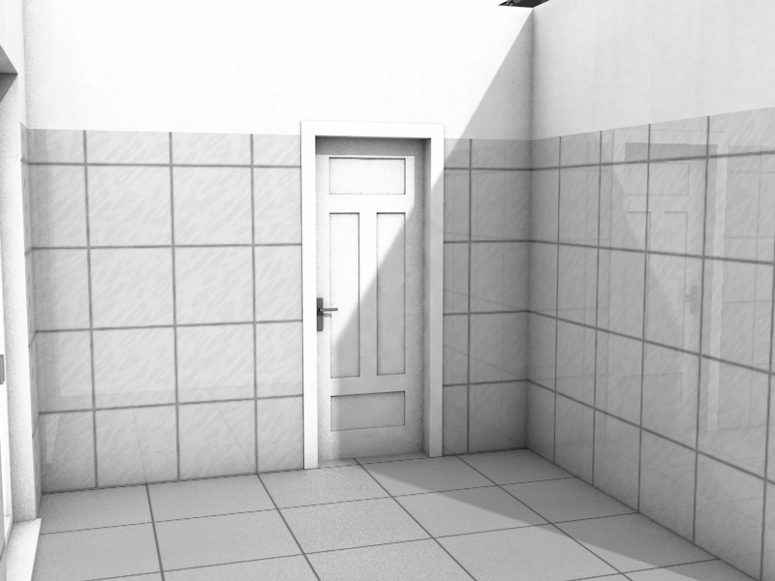

Slide 3
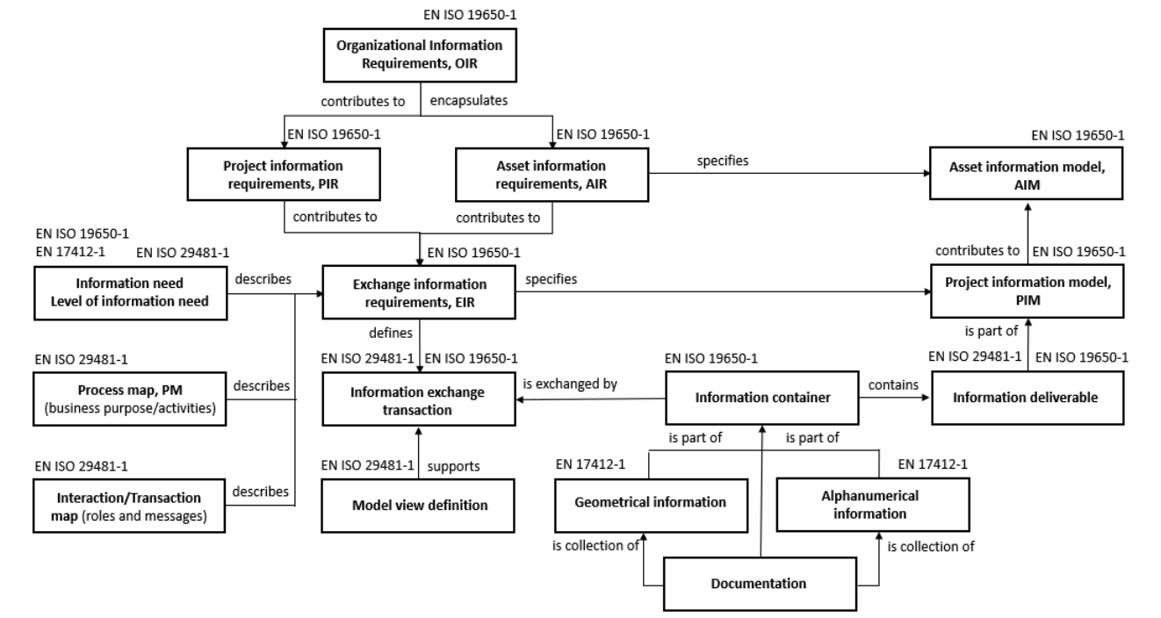
Conceptual relationships 19650-1, 29481-1 and 17412-1

Slide 4
The concept is defined in EN ISO 19650-1
level of information need – framework which defines the extent and granularity of information
Note 1 to entry: One purpose of defining the level of information need is to prevent delivery of too much information.
[SOURCE: EN ISO 19650-1:2018]
how much or how little information, and how detailed

Slide 5
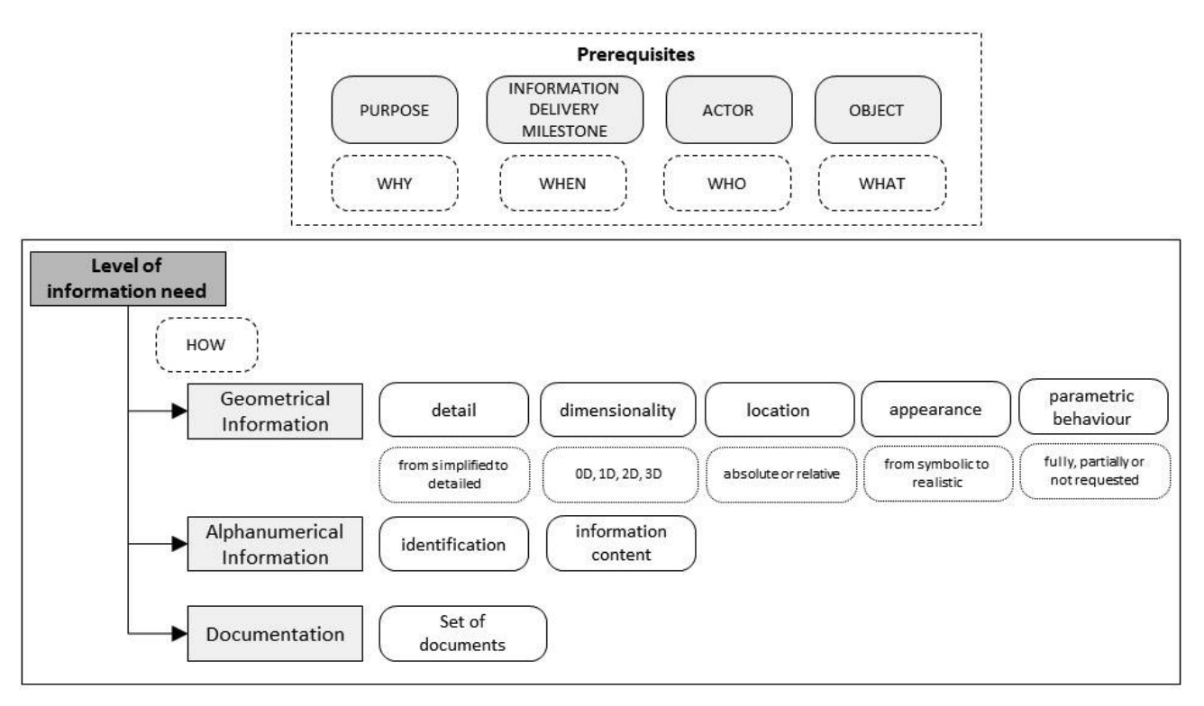
An overview EN 17412-1

Slide 6
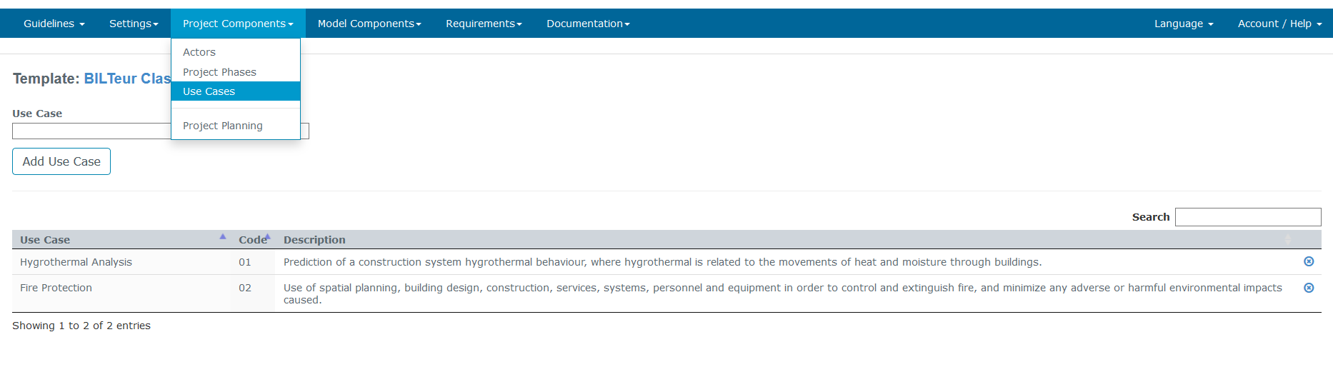
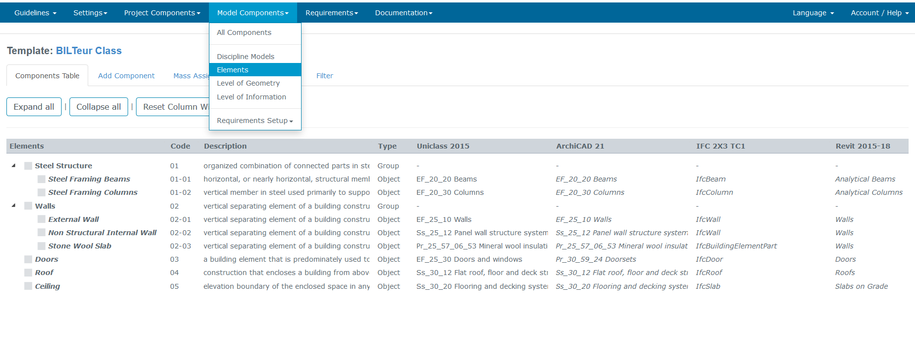
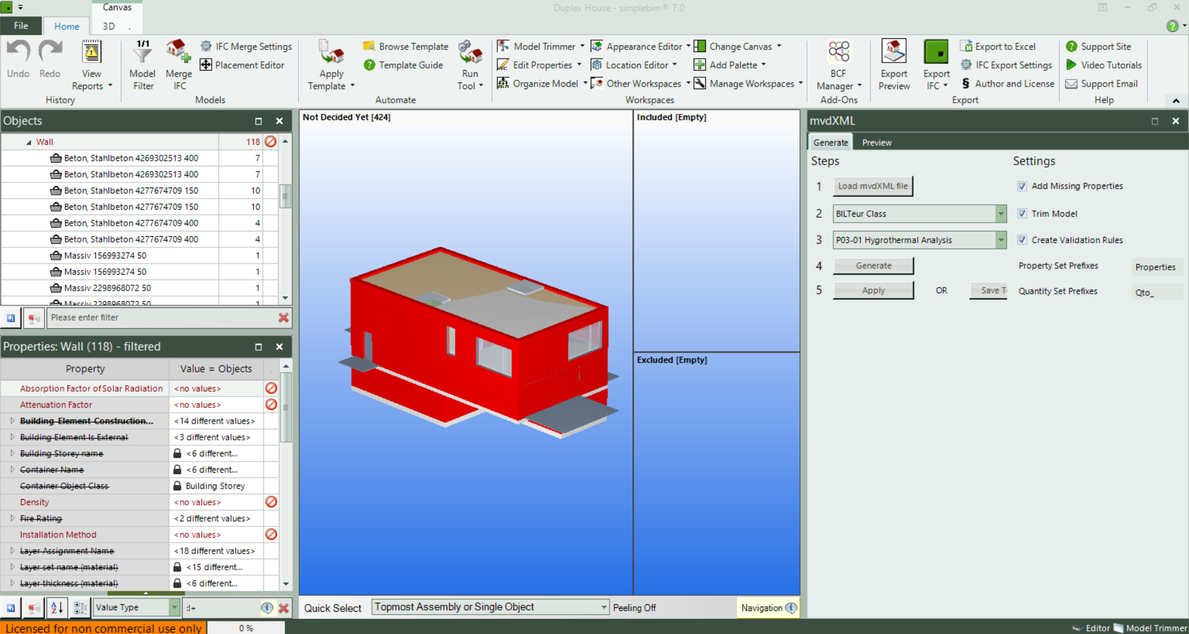
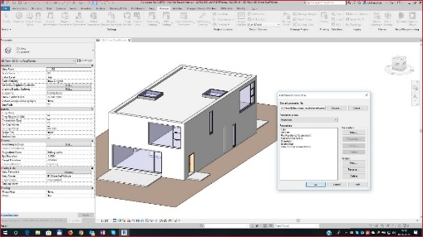
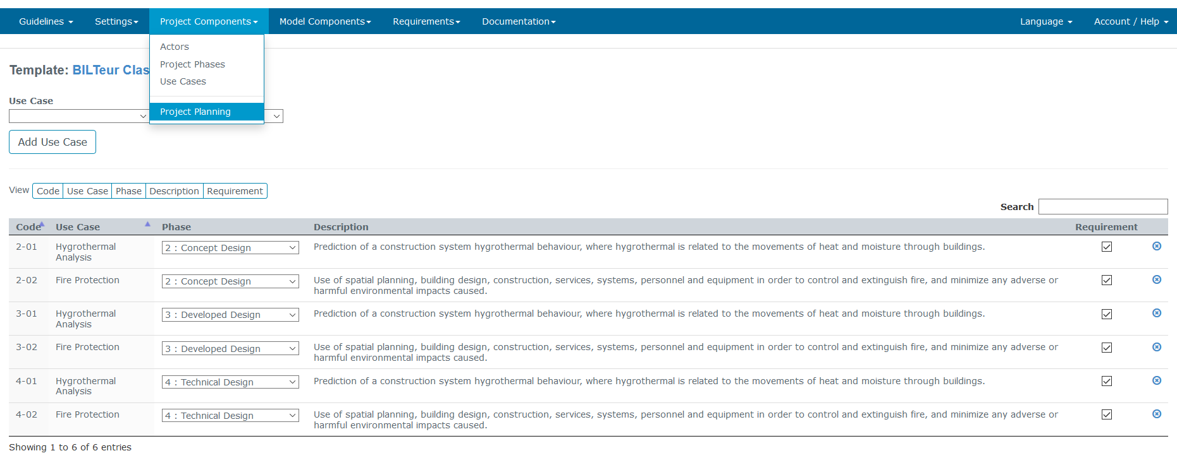
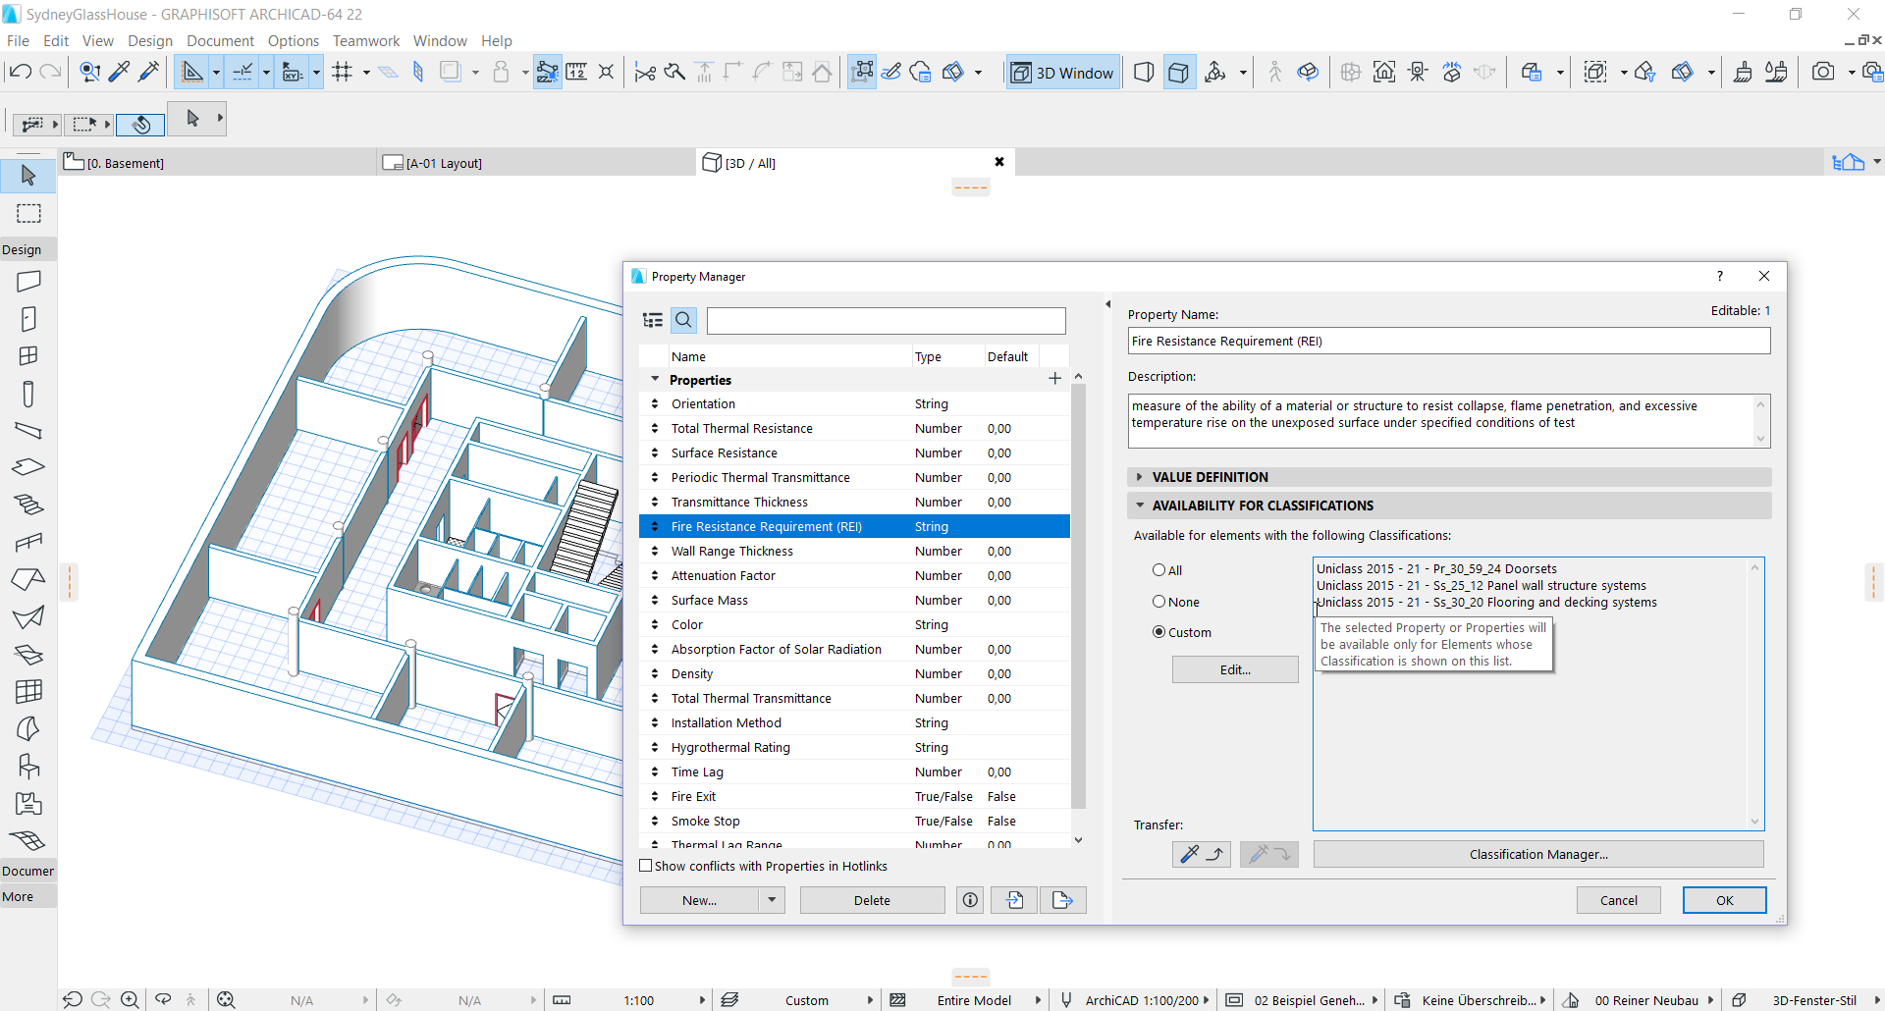
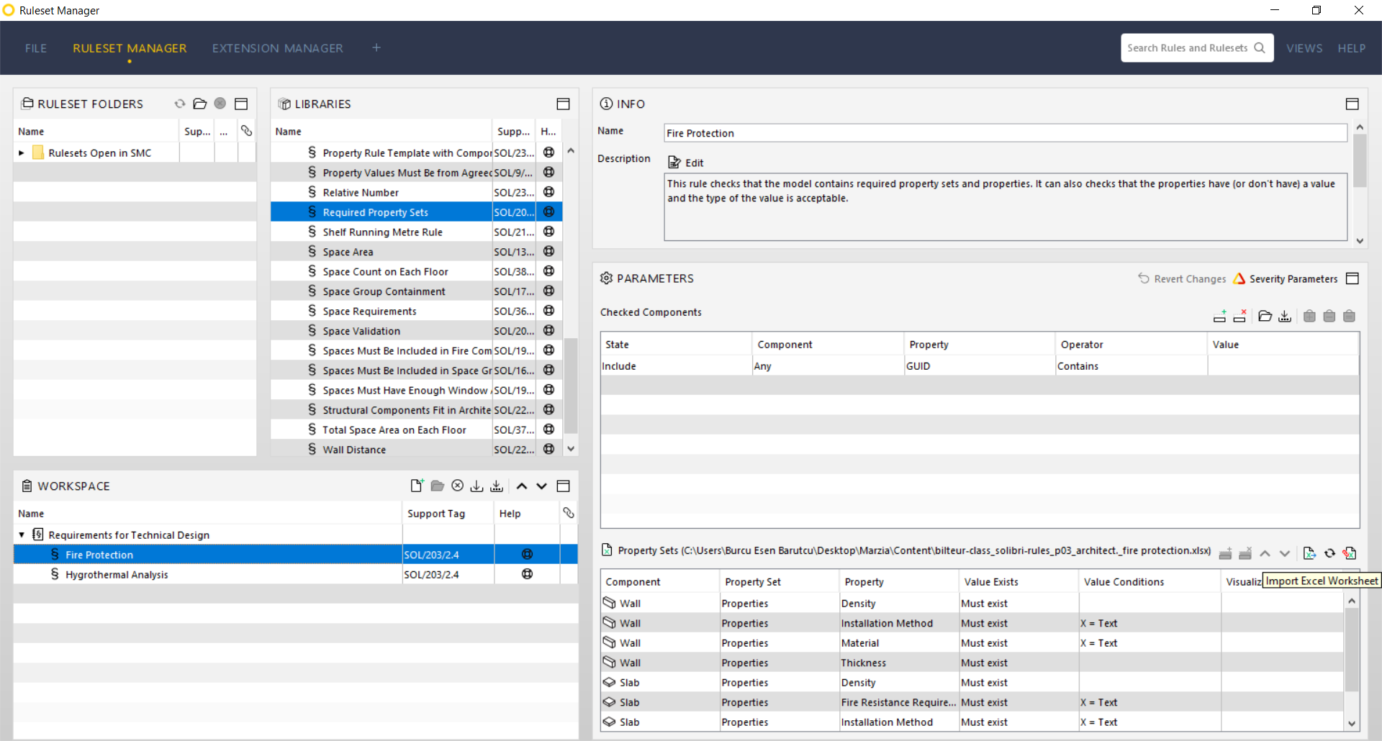
Define Requirements
Create information
Check

Slide 7
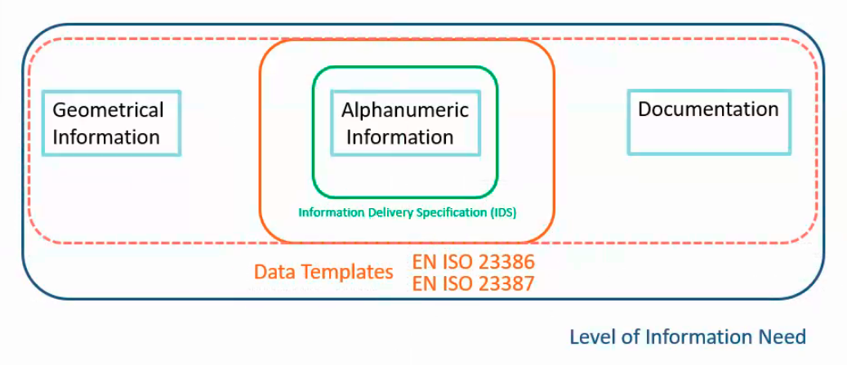
Level of information need to be specified
Three types of information:
geometrical information – description of detail and extent of information that can be expressed using shape, size, dimension, and location
alphanumerical information – description of detail and extent of information that can be expressed using characters, digits and symbols or tokens such as mathematical symbols and punctuation marks
documentation – collection of documents related to a given subject

Slide 8
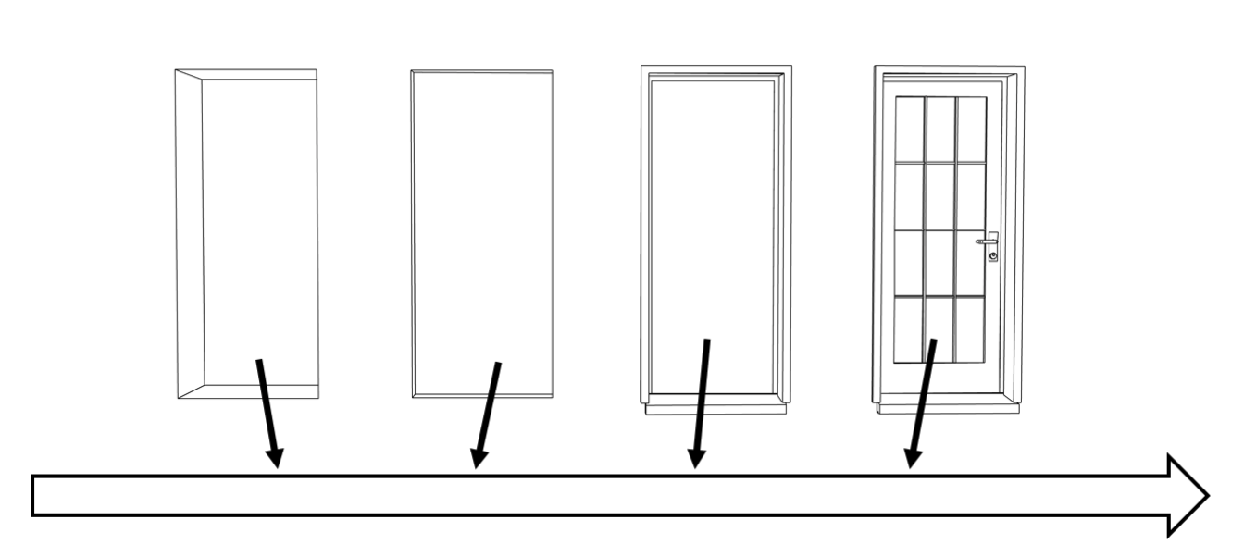
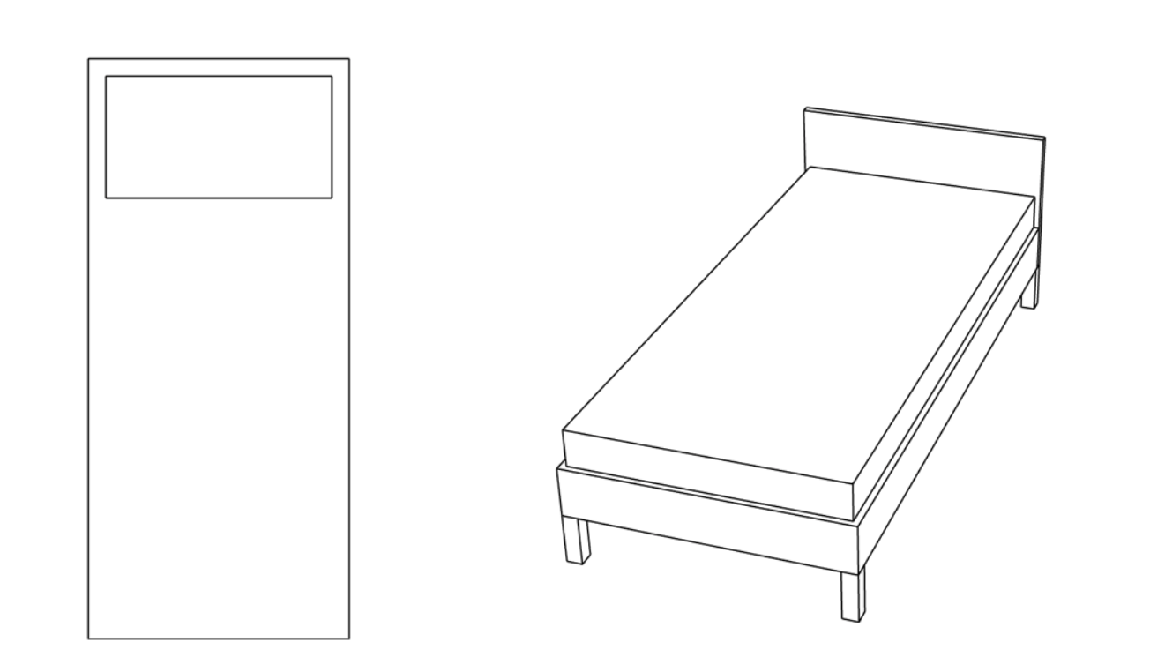
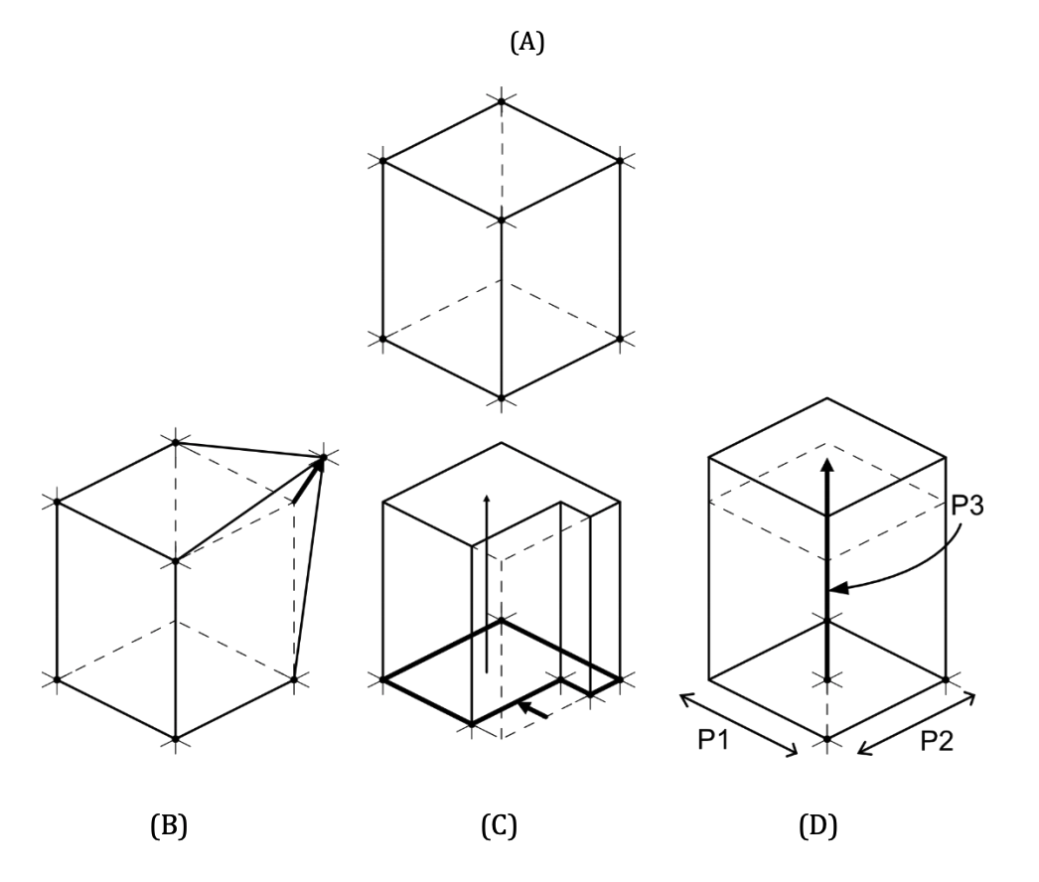
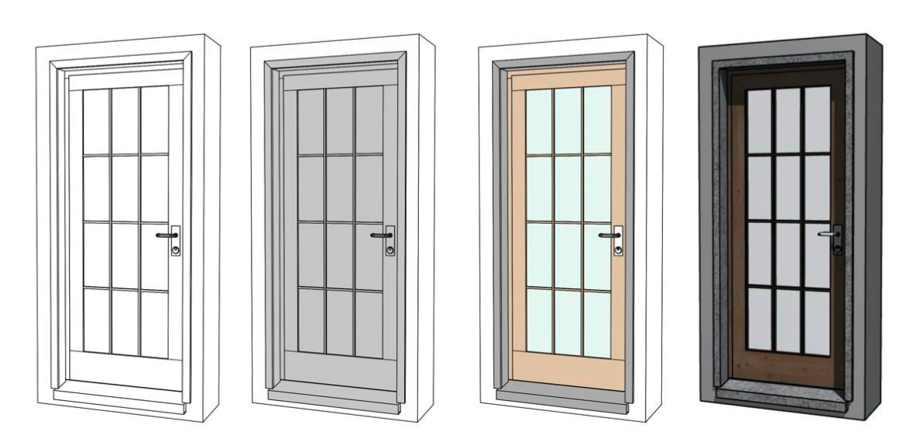
Geometrical information
Detail
Dimensionality
Location
Appearance
Parametric behaviour

Slide 9
Alphanumerical information
To specify the alphanumerical information for an object or a set of objects, the identification and information content should be specified.
Identification is used to position an object within a breakdown structure.
Information content is typically specified properties according to the defined purposes and the standards (EN ISO 23386 and EN ISO 23387).

Slide 10
Documentation
The documentation for an object or set of objects to support processes, decisions, approvals and verification of information deliverables should be specified as a set of required documents.
Documentation is typically a collection of documents related to a given subject and/or to a purpose, e.g.
an application for building permit
a collection of models, drawings, specifications and tendering lists for tendering and bidding
The result of a phase or a process to be the basis for the next process

Slide 11
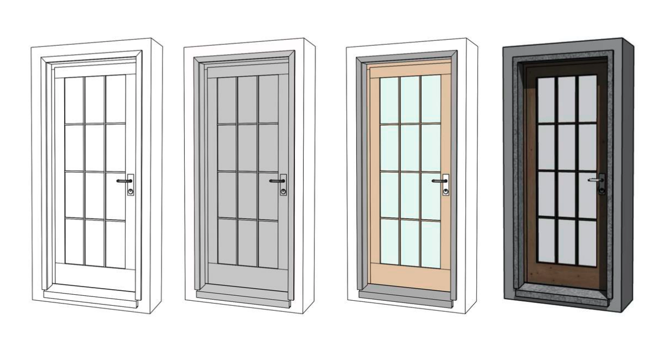
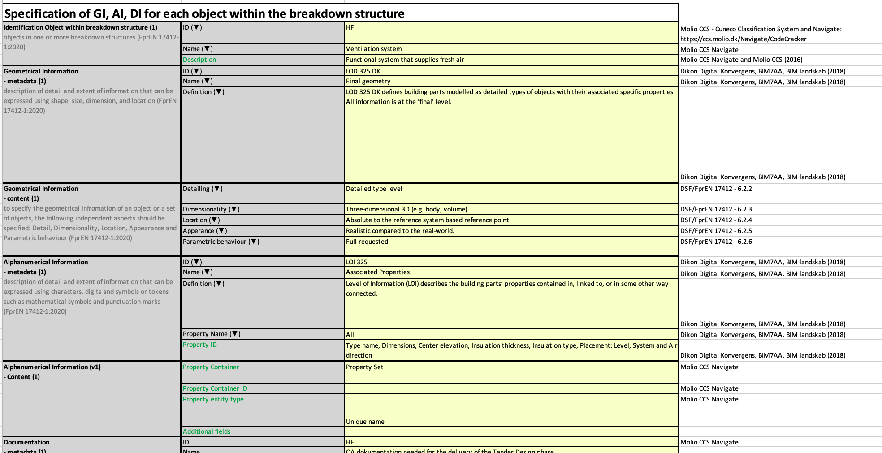
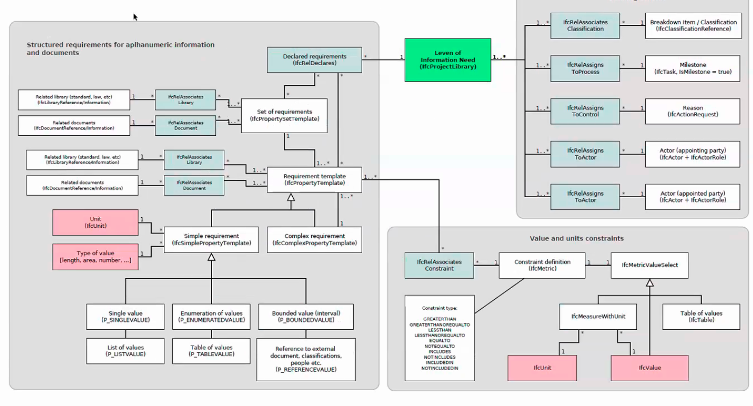
Level of information need – 3 standards
Part 1 – Concepts and principles
Part 2 – Application
Part 3 – Data Schema

Slide 12
